Slide 1
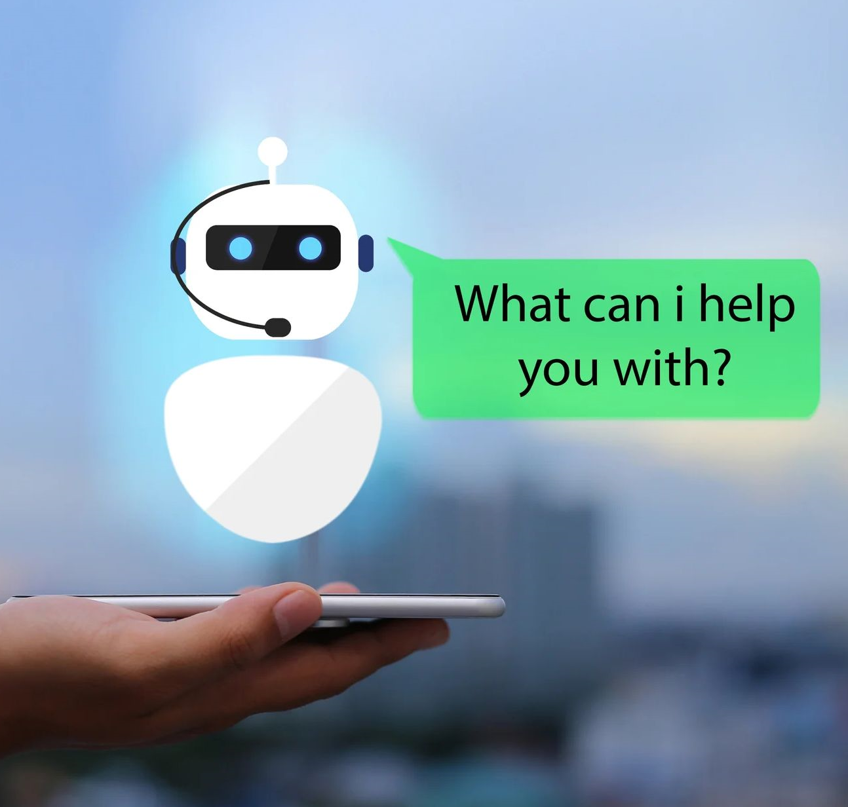
Architecture proposal for chatbot interaction
Strategy & Architecture
Retail Sales & Distribution

Slide 2

History and motivation
Clear request from our management directors:
After the last MIM division „Strategy & Architecture“ was approached to develop a concept for implementing a chatbot solution for AT
ED MD Ekkehard Preis asked Christoph Merte to develop a sound chatbot architecture including George Masterbot and stated the very clear expectation that we implement the best possible integration George Masterbot to Local AT Chatbot Solution
Scope and challenge
Initial scope: Chatbot architecture with special focus on George integration, interaction flow and components/services needed.
Wider scope: Elaboration of a bullet proof cooperation model between George and ED platforms AI Solution and MiSOL (definition who is expected to perform which tasks).
George AT: M.Krajinovic, P.Koller
AI Solution: F.Mayer
Product Owners within Business for Chatbot Solution (MiSOL): M.Gyarmaty (customer facing), H.Theisl (employee facing)
Out of scope: Comprehensive AI TOM (Target Operating Model) and AI Governance.

Slide 3
Final recommendations from Chatbot Challenge 2023
Source: 20231011_ChatbotChallenge_Steering.pptx
Toolstack for ED Chatbot Solution (MiSOL) and Architecture
As sandbox tests with Google toolstack are very promising and migration of ED solutions to Google Cloud Platform (GCP) is an ongoing initiative we highly recommend to implement this Google toolstack asap (DialogFlow and Vertex AI as a LAB-environment)
Architecture (esp. MiSOL, AI Solution and George) described by a separate initiative
Target Operating Model for conversational interfaces (aka chatbots)
Based on the future chatbot architecture an operating model (idea – development – production – operation) has to be elaborated and agreed upon the various stakeholders/keyplayers
Sufficient staffing to fulfill the business requirements (ideation, development, operation) within MiSOL Solution
Implement SPOC (Product-Owner) within the Bank
Clear responsibility on ideas, initiatives, requirements, priorities and budget are a key success factor
Start with joint work and designated Product Owners: customer facing bots with Marc Gyarmaty, employee facing bots with Hannes Theisl
Start with the integration of George Master Chatbot
As George Master Chatbot is a very prominent business stakeholder we recommend to start with this integration, utilizing already existing local chatbot or info-services
Product Owner: Peter Koller
Officially finish Chatbot Challenge

Slide 4



George concept for all countries: Hey, George is a new AI based conversational platform providing unified experience in an ecosystem of chatbots
Source: Hey, George! POC introduction.pptx
High-level architecture
1
Masterbot
Handover local bot back to Masterbot
Handover Masterbot to specific bot
1
Feature bot
1
Chitchat
1
Other centrally managed bots
2
Foreign Currency Exchange bot
2
Insurance bot
2
Other locally managed bots
3
Service center chat
Handover local bot to human support
1
2
3
Central bots & “Masterbot”
Local chatbots
Human support
Features
Masterbot as orchestration layer to correctly route client conversation
Chatbot knows the client identity
General chit-chatting functionality
George Feature search
Human handover support
Handles local scenarios and support cases
Handover from other bots (reactive/ question based)
Triggered by use cases where solution requires human intervention or user is not satisfied with chatbot solution
Solution
Provided & maintained by the central George team
Driven by ChatGPT models and IBM Watson
Provided & maintained by local banks
Can be running on any AI technology
Chat is handed over from master bot with the chat history
Run & maintained by local banks
Can be running on any CC technology

Slide 5
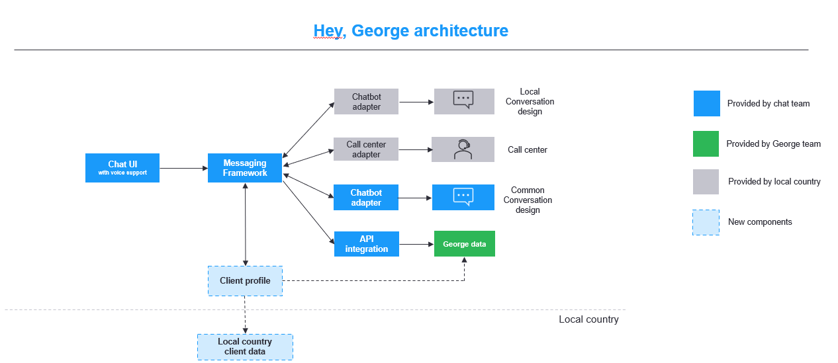
George concept for all countries: Hey, George is a new AI based conversational platform providing unified experience in an ecosystem of chatbots

Slide 6
Architectural principles
In the George context – One central GUI for the user
A customer only interacts with the George Chat UI (Web, App)
The George Masterbot covers a range of "core" usecases
The Master Bot can call "local bots" via an API ("George Messenger Protocol") which then return respective answers to the Master Bot
The Master Bot is agnostic of the local bot solution
Google cloud = strategic CSP
Google cloud services (Dialogflow / VertexAI, ..) are preferred.
MS Azure Services (e.g. GPT-Endpoint) are supported
Only for good reasons other CSPs may be used.
MiSOL will be moved to GCP 2024.
Modernized architecture based on GCP Dialogflow will be preferred over MiSOL when implementing new bots.
Example: Login support bot.
Bots should be channel-agnostic
Besides George bots should be usable by other clients
Erste Bank web page.
Intranet
Alexa
Google Home
…

Slide 7





Integration of central and local (AT) components (MiSOL)
George
Erste Web Sites
3rd Party Platforms
George Client (Hey George)
Public Website
Intranet (EON)
Google Home
Amazon Alexa
Meta client
Frontend
George Master BOT
Components
Operations Dashboard (e.g. turning BOTs on and off)
Monitoring and Logging (CLJ, LUX,…)
Chat Client
Bot Designer
Bot-Fabrik / DialogFlow
Bot Orchestration Layer and Middleware (MiSOL)
IT Operations
Local BOT Execution and orchestration
Model and Implementation
Backend and Tools
Development environment
Java / Python / …
Service / API
Local BOT 2
Agent Model
Flows
Local BOT 1
Agent Model
Local BOT n
Pyhton Script
Dialog flow
Sub Bot Flow
API call
Sub Bot Flow
Models
API Gateway (A. Steiner)
API Services
Core Service (A. Steiner)
AI Solution (F. Mayer)
Externally provided service
Domain API
LLM API
(GPT, PaLM, ..)
Vector Search
External API
Domain API
LLM API
(GPT, PaLM, ..)
External API

Slide 8
Who is taking the lead for a specific AT chatbot usecase?
I need some local support to answer questions.
MiSOL
is taking the lead
George AT
If AI-Services are needed, they will be requested from AI Solution
I would like to have an AI-powered
super-something.
AT cust.facing
If Chatbot-GUI is needed, this will be requested from MISOL.
Do you need a conversational interface like a chatbot?
AI Solution
is taking the lead
AT empl.facing
YES
NO

Slide 9



AT Chatbot usecases: How MiSOL and AI Solution work together
Idea: Business-request for a conversational interface comes in – via Product Owners (M.Gyarmaty, H.Theisl, P.Koller or N.N) or MiSOL or AI Solution – who is doing what? For all use cases except those handled by George Masterbot
Who is taking the lead from idea to production? | Model 1: Click or NLU-BOT | Model 2: AI-Chatbot | Model 3: AI-"Tool"
Clarifying requirements Designing Interaction Flow Preparing User-GUI and Orchestrating Services Managing the UseCase or Solution | MiSOL | MiSOL | AI Solution UserGUI provided by MiSOL if needed
Manage all GenAI-Services needed (eg RAG-Pipeline) Dealing with Content Development & Operation of AI-Service as Managed Service | MiSOL | AI Solution Temporary support by MiSOL possible | AI Solution
Providing access to AI Services as Tools as they are ("empty" instances of vector-databases or LLMs as provided by vendors or open source) NOT dealing with Content | MiSOL Utilizing built-in GenAI features of BotDesigner (DialogFlow) | AI Solution | AI Solution
Examples to illustrate | "Hey George!" Local Bot Usecases Website/BON Bot Usecases sKontakt "Auto Reply" "Grants"-Bot FATCA-Bot GMSG-Bot | Research-Bot Legal FAQ | "Working Instructions" FinHealth Assistant (in future)??

Slide 10
Stakeholders, roles and responsibilities in ED and EB
AI Solution (C. Helm)
Provides API Services
LLM Endpoints (GPT, PaLM, LLAMA)
Vector Database
Vector Search
Operations
Billing
Monitoring
Resource management – external resources on demand.
Development resources.
Remark: TOM for AI Solution is still under construction.
MiSOL (E. Preis)
Provides conversational interfaces and ”Chatbots” for end users
Orchestrates services (implementation of actual logic and usecases )
Operations
Provides service lifecycle management
Makes solution management
Resource management – external resources on demand
Development resources
George team (George AT/G-LABS)
UX Integration
George Masterbot (incl. FeatureSearch, ChitChat, Call Local Bots, …)
Operation with ED George Retail/Business
Product Owner: Peter Koller
Business (EB)
Product owner (SPOC)
Marc Gyarmaty – customer facing (retail)
Hannes Theisl – employee facing.
Retail / Corporates split?
Tasks
Defining requirements.
Collecting ideas.
Managing backlogs.
Test the solutions (UAT).
Business owner
Has demand – business need.
Has budget.
Budget / Funding.
Currently still to be defined, just ideas.

Slide 11

Target operation model (TOM) for integration George chatbot - local chatbot solution (MiSOL)
Work is currently in progress (Peter Koller is the responsible person)
Scope
Enhancing central Hey!George chatbot capabilities by integrating local chatbots.
Change process
Is the same as for any other George component.
Operational processes
Roles, handling of requirements, interaction George with Local BOT.
Lanes concept.
Turning BOTs on and off on demand.
Monitoring.
All those aspects are to be specified in detail until mid of November 2023.
To be presented soon by Peter Koller.

Slide 12


Slide 13

Let us work together…

Slide 14
Thank you !!

Slide 15
The core team
Name (alphabetic order) | OU | Role
Gyarmaty Marc (EB) | 0443 - Vertrieb Digital | Product owner for MiSOL SPOC for customer facing retail.
Koller Peter (EB) | 0442 - George Retail | George Product Owner – Retail
Makovicka Walter (ED) | 6488 - Enterprise Architecture | Enterprise Architecture chapter lead “Customer Engagement”
Mayerhofer Reinhard (ED) | 6367 - Customer Journey & Leasing | Head of Department
Neulinger Juergen (ED) | 6045 - Group Statutory Reporting Services | Solution manager for “AI Solution”
Pfandl Max Anton (ED) | 6488 - Enterprise Architecture | Architect expert for integration in IT landscape and UX
Stabentheiner Erik (ED) | 6491 - Agility & Innovation | Business Analyst Expert for machine learning and data science
Strimitzer Albert (ED) | 6488 - Enterprise Architecture | Architect Expert for cloud topics and UX

Slide 16
2 high priority use cases Source: INNO AT Use cases
Name | Description
Integration George masterbot to MISOL | Demonstrate Bot integration
George Login / FAQ Bot | Supportive chatbot on FED Login Page

Slide 17
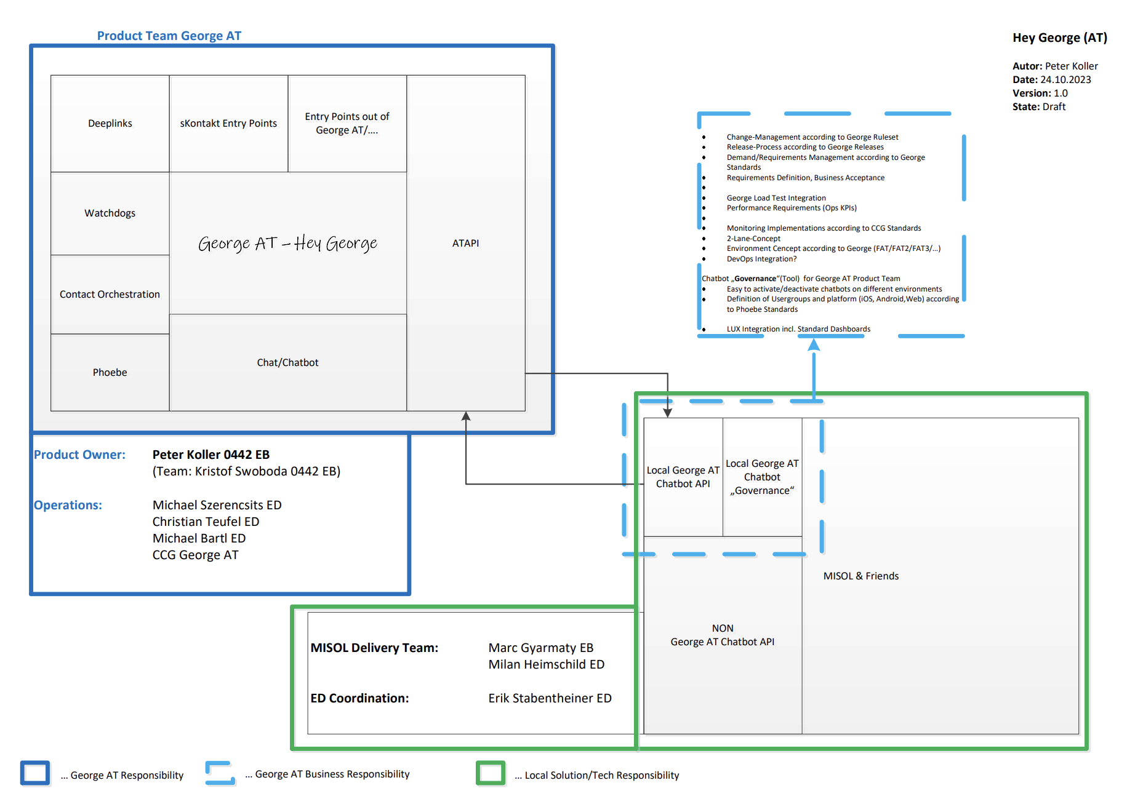
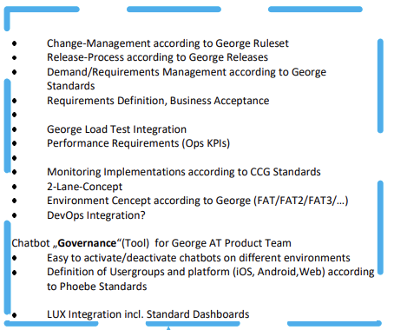
George and MiSOL communication details
ProductOwner GeorgeAT: Peter Koller

Slide 18
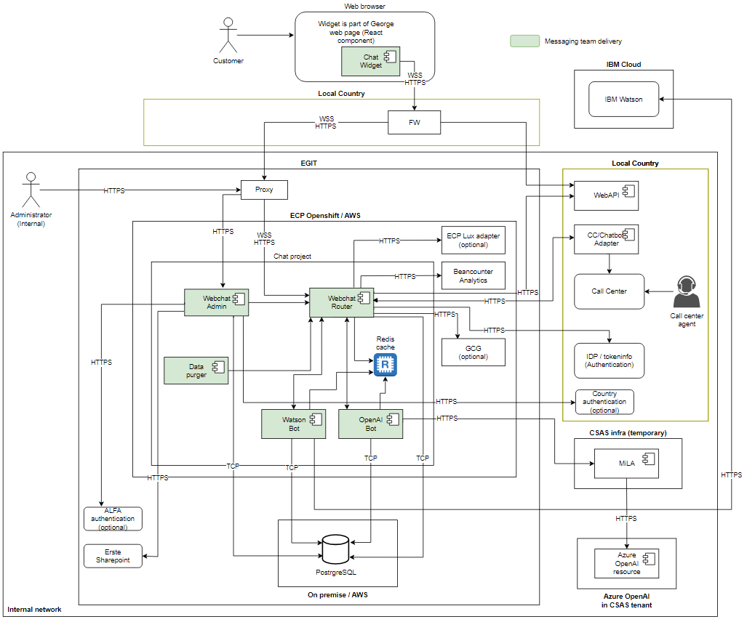
Hey George architecture in detail

Slide 19
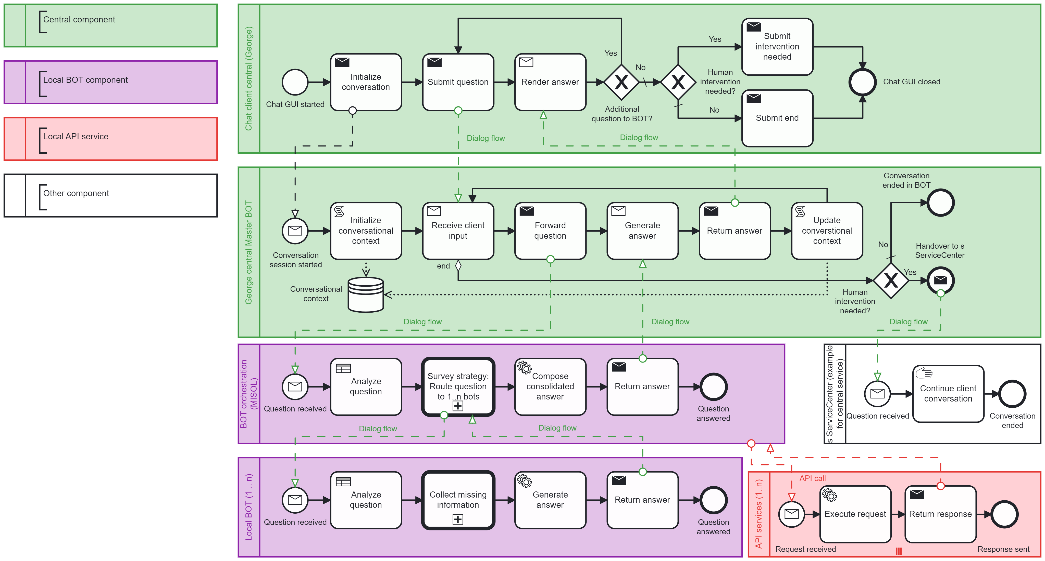
Chatbot flow in George context for AT
Source: MainJourney (cawemo.com)

Slide 20
Backup slides

Slide 21
Integration of central and local (AT) components (MiSOL)
George
Erste Web Sites
3rd Party Platforms
George Client (Hey George)
Public Website
Intranet (EON)
Google Home
Amazon Alexa
Meta client
Frontend
George Master BOT
Components
Operations Dashboard (e.g. turning BOTs on and off)
Monitoring and Logging (CLJ, LUX,…)
Chat Client
Bot Designer
Bot-Fabrik / DialogFlow
Bot Orchestration Layer and Middleware (MiSOL)
IT Operations
Local BOT Execution and orchestration
BOT Model
Backend and Tools
Service / API
Local BOT 2
Agent Model
Flows
Local BOT 1
Agent Model
Local BOT n
Pyhton Script
Dialog flow
Sub Bot Flow
API call
Sub Bot Flow
Model deployment
Internal API (Presto)
AI Solution service
LLM API (GPT, PaLM, ..)
External API (Weather, etc.)
Vector database
Vector Search
API Services

Slide 22

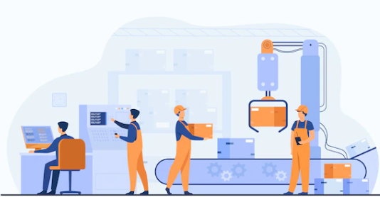
Target operation model (TOM) high level activities
From idea
to production
New service (partly iterative)
Creating a new idea.
Assessing business benefits and funding.
Designing the model.
Assessing dependencies.
Creating new services if needed.
Implementing the new model including ISD.
Clarification of Service Level Agreements (SLA).
Testing the model.
Rolling out the model to production.
Operating the model.
Change management (partly iterative)
Requesting a change.
Assessing business benefits and funding.
Approving or denying the change.
Changing the model.
Assessing dependencies.
Creating new services if needed.
Implementing the changed model including ISD.
Testing the model.
Rolling out the model to production.
Operating the model.

Slide 23
History and motivation – initial slide
After the last MIM division „Strategy & Architecture“ was asked to develop a concept for implementing a chatbot solution for AT.
Main stakeholders are managing directors Christoph Helm and Ekkehard Preis.
Both see chatbots as a business critical feature.
Scope and challenge
Initial scope: "Hey George!" chatbots for George Retail AT. A central chatbot leads the conversation and calls out to local chatbots on demand.
Wider scope: Additional channels like Erste landing web page for non-customers should be considered in the target picture.
Challenge: Integration into the IT landscape in AT.

Slide 24
Stakeholders, roles and responsibilities in ED and EB (old)
MISOL and/or AISolution (ED)
Provides new/changed conversational interfaces.
Orchestrates services (implementation of actual logic - backend)
Operations
Provides service lifecycle management.
Makes solution management.
Resource management – external resources on demand.
Development resources.
Business (EB)
Product owner (SPOC)
Marc Gyarmaty – customer facing (retail)
Hannes Theisl – employee facing.
Retail / Corporates split?
Tasks
Defining requirements.
Collecting ideas.
Managing backlogs.
Test the solutions (UAT).
Business owner
Has demand – business need.
Has budget.
Budget / Funding.
George team (George AT/G-LABS)
UX Integration
George Masterbot (incl. FeatureSearch, ChitChat, Call Local Bots, …)
Operation with ED George Retail/Business
Product Owner: Peter Koller
Currently still to be defined, just ideas.

Slide 25
Under the hood - Orchestration
MISOL in GCP is the orchestrator.
Calls additional bots via API as needed.
..

Slide 26
Under the hood - Integration
Bot to bot
Definition of an API for calling a bot.
The API is defined as a group API here: ….
Event tracking is done via LUX.
Bot to backend
RESTful calls to APIs via APILM Red Hat 3Scale.
….

Slide 27
Target operation model (TOM) #2
Information from Chatbot-Challenge
Target Operating Model for conversational interfaces (aka chatbots)
Based on the future chatbot architecture an operating model (idea – development – production – operation) has to be elaborated and agreed upon the various stakeholders/keyplayers
Sufficient staffing to fulfill the business requirements (ideation, development, operation) within MISOL Solution
Implement SPOC (Product-Owner) within the Bank
Clear responsibility on ideas, initiatives, requirements, priorities and budget are a key success factor
Start with joint work: customer facing bots with Marc Gyarmaty, employee facing bots with Hannes Theisl
Proposal for a TOM for generative AI
GenAI_TOM Approach.pptx (sharepoint.com)

Slide 28
Components
Frontend
Solution
Backend
George with Chat-GUI
External Services
MiSol
Orchestration Layer
External Website with Chat-GUI
AI Solution
Bot-/Dialog Designer
Internal Website/ Webapplication
Internal Services/ Applications

Slide 29
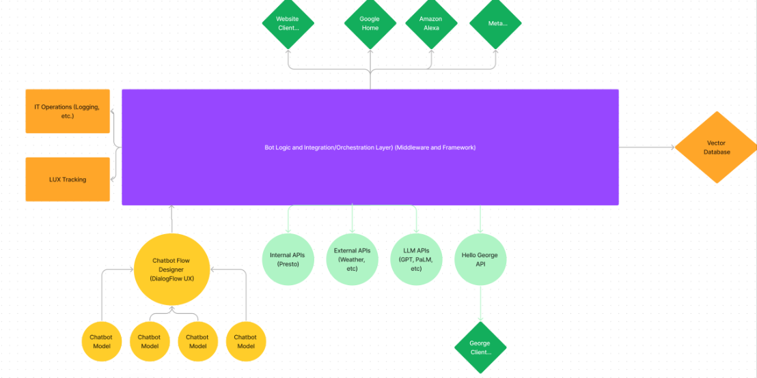
Flows

